Slide 1
OneDeliver Cloud Transformation with IBM RedHat

Slide 2


Common Customer challenges
Key Drivers for
Portfolio consolidation and cloud roadmap
Modernize on-premise and legacy applications
Cloud native applications
Savings on TCO
Reduce infra administration and focus on business functions
Accelerators built on industry best practices
Automation for faster time to market
Resilient, Secure, scalable and highly available architecture
Hybrid Multi-cloud
Governance and Compliance
Cost Reduction
Operational Complexity
Trusted Advisor
Compliance and Regulations
New Engagement Models
GDPR
Cloud Readiness
Manage Holistically & Agility across clouds
Business Agility
Lower Deployment and Maintenance Costs
Choosing right tools
Integrating multiple clouds
Cost Uncertainty
Vendor Lock-in
Portfolio complexity
Business Significance
Legacy Modernization
Dynamic Markets
Future Pricing Model
Technology Complexity
Portability
Complexity of Infrastructure deployment
Lack of expertise & knowledge
Criticality
50%
Movement
between clouds
92%
58%
$$
20%
Applications
in Cloud
Market
Analysis
Enterprises moved to hybrid multi by 2030
Enterprises with hybrid cloud
Enterprises could go Multi-Cloud
Savings with
licensing
benefits
70%

Slide 3


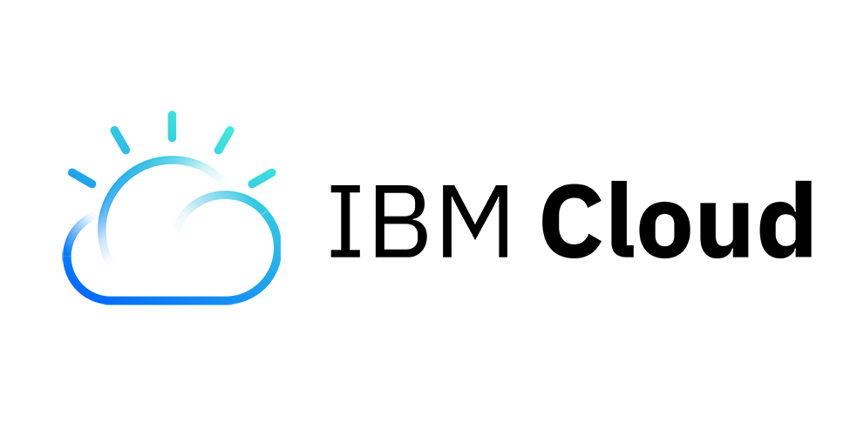


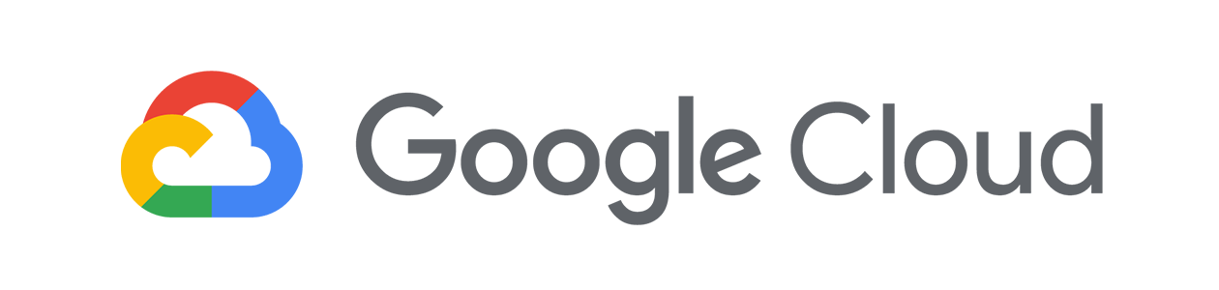

IBM Cloud Portfolio
HYBRID MULTICLOUD OFFERINGS
DOMAIN SPECIFIC OFFER
Advanced Technologies
AI | Analytics | Blockchain | Encryption | IoT | ML | Quantum
IBM Cloud for
Financial Services
Capabilities &
Cloud Paks
Application | Data | Integration | Multicloud | Automation | Security
RedHat OpenShift on “ANY” Cloud
Bank applications & workloads | 3rd Part SaaS applications
Foundation
Kubernetes
Cloud Databases
CI/CD
Serverless
Schematics
Runtimes
CFEE
DLaaS
IBM Policy Framework for Financial Services
Common
Logging & Monitoring | IAM | KYOK/BYOK | VPC | API & console
Cloud Native | VMware |
RedHat OpenShift
Infrastructure
Bare Metal | VMs | Power | z | VMware | Public | Dedicated
Global Network
Multi Zone Regions (MZRs) | Single Zone Regions (SZRs) | Data Centers (DCs)

Slide 4
Cloud Paks Value-Adds and Savings
Cloud Pak for application value-adds
Cloud Pak for MCM –Value-adds
Monolithic apps and databases Large, complex, difficult to innovate
Cloud native architecture
Adopt a common model based on containers and microservices
Development, Security, Operations in silos
Merged workflows to enable DevSecOps velocity
Slow service delivery
Inefficient development; inaccessible data
Innovate and leverage investments
Understand when to refactor, replace, move, or maintain existing apps with data
Separate tools for VM’s, Containers & COTS
Open-standards & unified tooling in one complete automation solution
Siloed organizations
Development and IT operations
High performance agile culture
Leverage DevOps & DataOps methodologies to achieve continuous delivery
Many point products that don’t add up to a complete solution
Integrated, pluggable core – extendable with your own capabilities (BYO)
69%
Experience more rapid growth; better security for company and customer data
75%
Improvement in overall IT efficiency
63%
Have improved employee productivity rates
Cloud Pak for application savings
Cloud Pak for MCM savings
25%
75%
25%
9%
66%
40%
50%
52.5%
66%
Application development cost savings
System configuration cost savings
System management
cost savings
IT capital cost
savings
Application acceleration benefits
Avg. Application developer productivity
Avg. SRE productivity
Security productivity
Avg. IT operational efficiency

Slide 5




IBM with Sogeti-OneDeliver
OneDeliver Services
Key Drivers
Use Cases
IBM Offer
Application Assessment
Analyze on-premises workloads for modernization
Cloud Pak for Applications – Transformation Advisor
Cloud native new apps
Create microservices based apps and adopt DevOps, CI/CD for greater agility
Cloud Pak for Applications
Application Modernization
Refactor legacy applications & integrations using containers & cloud native technologies
Cloud Pak for Applications
OneMigrate
OneNative
Containerize the legacy or cloud native applications with Kubernetes Orchestration
Container Orchestration
OpenShift
Secure Env Provisioning
Provision new environment securely and quickly in any cloud
OpenShift
Run
AI Ops & Multicloud Mgmt
Monitor, Manage & automate operations & workloads across Multicloud environments.
Cloud Pak for Multicloud Management
MCM essentials
Attach MCM with App and Integration use cases or trade up/ upgrade existing customers
Cloud Pak for Multicloud Management
AI | Analytics | Blockchain | IoT | Hyper Protect | ML

Slide 6

Business Scenarios
App Modernization
Build for Cloud-native
Multicloud Management
Large-scale App Modernization with Run
Longer term services engagement (3-5X)
Transformation engagement/ managed services
Strategic outsourcing/ managed services
Application migration on Kubernetes
Target Customers
6000+ WebSphere customers using WAS, IIB or MQ
Existing JEE customers using other App servers
Existing JEE customers moving to micro-services development
Enterprise building application for cloud
Managing hybrid env across multiple clouds and enterprise data center
Outsourcing IT Operations
Enterprises looking to leverage cloud capabilities
Customer Scenarios
Development agility
Business agility
Right-sizing & modernizing
Portability by containerizing workloads NOW!
Build modern cloud applications to reach market quicker
Manage scales and spikes
Containers & DevOps adoption
Continued business operations
Achieve Zero downtime
Move applications from one cloud container platform to other
DC Exit cloud migration
Managed Services
OneDeliver Services
OneMigrate
OneNative
OneNative
OneMigrate
OneNative
Run
Run
Run
Key
Value Proposition
Access to new value-added capabilities
Protect existing investments for IBM customers
Flexible licensing option – On-demand ability to mix and match capabilities
An optimized & certified set of frameworks & runtimes to build portable & resilient cloud native applications
Integrated DevOps toolchains
Digitally extend traditional businesses
Run anywhere on OCP
Low risk, low cost of cloud native environment
Achieve complete DevSecOps value circle
Open-standards & unified tooling with a pluggable core
Consult on SRE best practices and provide managed services for Intelligent IT Ops
Gain the flexibility and agility to choose your preferred cloud platforms and migration methods
Experience expanded through more availability zones in high-demand centers
Quicker turnaround time
Modernize via containers or Function-as-a-Service capabilities
Self Healing

Slide 7
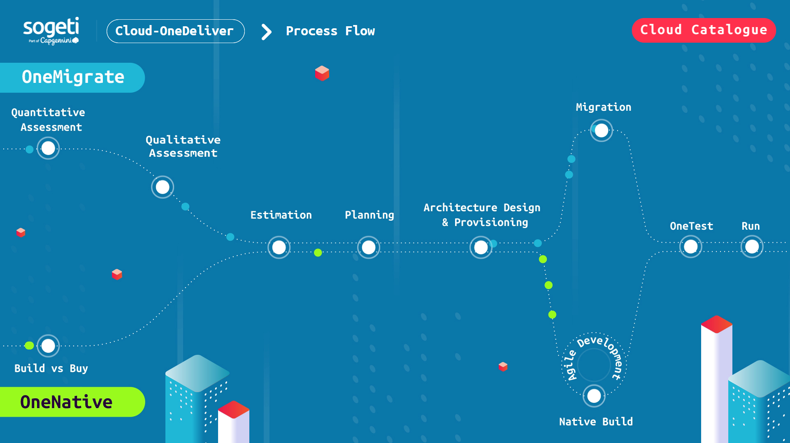
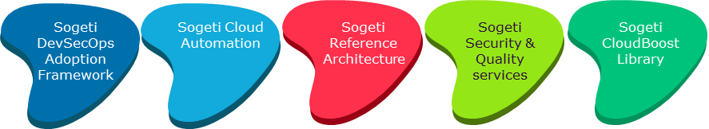
Framework
Setup Cloud Native Foundation
Sogeti OneNative Accelerators

Slide 8
Solution Deep Dive

Slide 9
Sogeti Value Proposition & OneNative Accelerators
40% Migration and 20% Cloud Native cost reduction
Sogeti DevSecOps
Adoption Framework
Sogeti Cloud Automation
Sogeti Reference Architecture
Sogeti Security & Quality services
Sogeti CloudBoost Library
Summary of accelerators
CloudBoost Library – Landing zone provision automation platform using reusable and standardized scripts / templates.
Sogeti Cloud Reference Architecture - Define a consistent and standardized architecture moving to Cloud
Sogeti Cloud Automation – scripts and templates for CICD pipelines, SRE implementation
Security & Quality Services – well defined Cloud Security and Quality testing standards and Frameworks
DevSecOps Framework – helps measuring DevOps maturity and adoption of Reference Architecture & standardization principles.
CoreFlex Squad Model - Core and flexible squad model to bring accountability for Migration Velocity and Team Right-Sizing
Accelerators Benefits
Suite of services to build applications to Cloud.
Transform with speed and flexibility at scale
DevSecOps methodology for Infrastructure and Application transformation.
Managed services via a unit-based pricing model.
Accelerators enabled capability for public cloud providers like Azure, AWS, GCP and IBM
Financial accountability by design in operations, Proactive Monitoring, bringing the DevOps culture and Continuous Right Sizing / Identify-consolidate
Migration Factory to help accelerate the migration velocity.
Our accelerators help to
Lower costs
Improve Security
Agility
Velocity
Our accelerators help to
Lower costs, improve security, agility
and velocity.

Slide 10

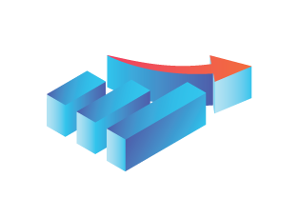


Our Assessment Approach
1
INITIATION
2
ANALYSIS
3
DEEP DIVE
4
REPORTING
Timeline (in weeks)
1
2
3
4
5
6
7
8
Activities
Identify and agree the stakeholders pertaining to In-scope Applications
Gather technical diagram & functional flow of application
Create & agree detailed assessment approach & plan
Identify list of business use cases within the application.
Collect application’s AS-IS performance metrics
Acquire application’s AS-IS architecture and Deployment diagram
Analyze collated application repository and plan deep dive workshops with respective SME, Leads & Tower Heads
Conduct Comparative study of As Is IT landscape, technology & functionality against Cloud Native application development
Identify non-functional requirements for the application in TO-BE design
Plan and conduct deep dive workshops with SME, leads and tower heads
Analyze application’s business functionality and map to the re-usable building blocks as part of AcceleRight framework, OneDeliver accelerator for Cloud Native Development
Consolidate assessment findings for Users, Functionality , Technology & Tools
Seek clarifications and additional inputs (if required**)
Prepare Application Cloud TO-BE Architecture
Measure Native Development Effort and Timeline
Review and sign off on Application Rewrite Approach, Design and Effort
Tools
Cloudscape & eAPM output (Application Dependencies, Application Qualitative Details -like technology, no. of users)
IBM Transformation Advisor
IBM Transformation Advisor
MS Visio (for TO-BE Architecture), MS Office,
IDEs (ex. Visual Studio, Eclipse) for Code Analysis, DB Client Tools (ex. PL/SQL Developer)
PaaS Analyzer, Evolveware
Owners
Customer
Customer
Deliverables
PaaS Analyzer Report,
IBM Transformation Advisor Report
Application’s Cloud TO-BE Architecture
Native Development Effort & Timeline

Slide 11

Iterative Execution Methodology
Gate
2
Gate
3
Assess the application AS-IS Server and application details
Identify logical service boundaries
Analyse data flow and connectivity
Identify the internal and external application integration points
Define Target Application Design
Define configuration as a code approach
Define Application resources provisioning Approach
Migration Strategy and Approach
Data Migration Approach
Assessments
Target Design
Iterative Cycles
Detailed Assessment
Migration Preparations
Migration
Cloud Landing Zone Provisioning
Requirements
Go Live/Cutover Hand Over
Gate
Identify the apps priorities
Define the migration batches
Go Live
7
Testing
Perform Go Live and cutover plan
Data synchronization and Verification
Approval on Go Live and Cutover Plan
Perform Cutover
Perform Go Live and transition to incumbent
Migration Signoff
Gate
1
Validation
Testing
App & DB Migration
Gate
6
Gate
4
Gate
5
Hub and Spoke defined
VNet and Subnets provisioned
Integration dependencies and endpoint configured
Application Feature Provisioning
IAM Approach configured
Validate deployments
Sanity testing
Migration issues resolution
UAT will be performed and signed off by client
Application resources provisioning
Build CICD
Application migration
Perform Database Migration
Configure Integrations

Slide 12



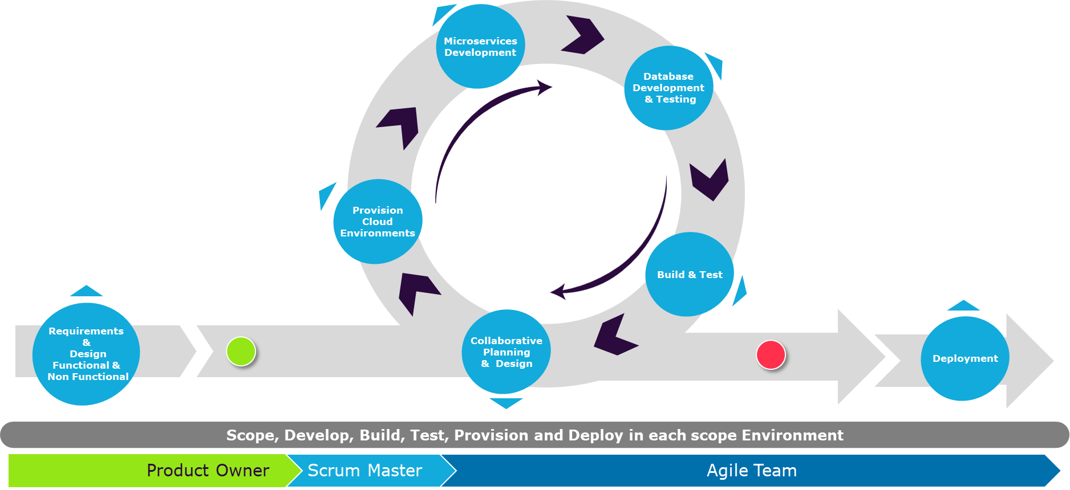
End to End Migration Path
Detailed Assessment
Migration
Testing
Go Live
Supervise & Monitor migration
Warranty Support/
Migration Specific Bug
Fixing
Service Switch
Cloud
Landing Zone Provisioning
Application
Resources
Provisioning
User
Acceptance
Tests
Go Live/Cutover Signoff
Hypercare
Migration Preparations
Target
Design
Database Migration
One
Deploy
One
Test
Rehost/
Re-platform Environment
App Deploy/
Provision
Discovery GAP Assessments
CloudBoost Library
DevOps
CI/CD Templates
Functional / Integration Tests
Retrofit &
Data
Synch.
Migrated Application Live!
Handover
Remediate Environment
Transition
Run Code Analyzer
PaaS Remediation
Landing Zone
PaaS Instance Provision
App Packaging
Increased speed, efficiency for cloud Migrations
Upfront Migration Complexity & Risks Report from Code Analyzer
Automated landing zone provisioning using CloudBoost Library
Reduced human errors due to standardizes scripts & templates
Standardized migration approach and security principles implementation
Reduced End to End Cloud Migration efforts up to 40%
CloudBoost Library
DevOps
CI/CD Templates
Rewrite / Rebuild App
Rewrite
Assessment
Buy vs Build
Reference Architecture & Design
Landing zone
Cloud Native Build
CloudBoost Library
DevOps
CI/CD Templates
Supported by Sogeti Accelerators

Slide 13
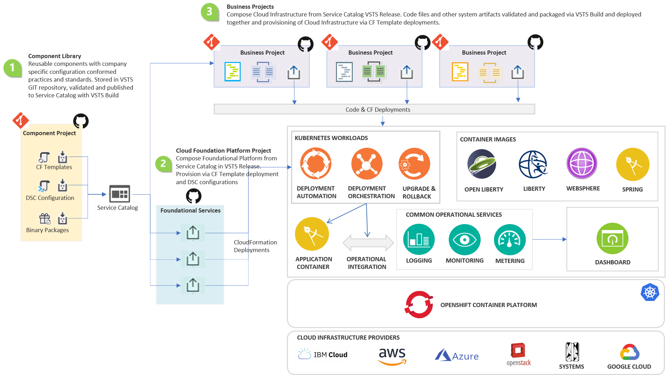
CloudBoost with IBM RedHat
What
CloudBoost is a set of GitHub library projects built using generic templates and scripts creates to provision independently deployable components and landing zones which can evolve independently.
Advantages
Increased speed, efficiency for cloud environment provisioning
Reduced human errors due to standardizes scripts & templates
Best environment design and security principles implementation
Inbuilt best practices for naming conventions and resource tagging

Slide 14
OneTest - We use standard criteria to select the best fitting tools
Cloud Functional & Automation
Cloud Non Functional Testing
Cloud Technical Testing
Cloud Infrastructure & Test Eco System Testing
Functional & Automation Testing
Cloud Performance Testing & Performance Monitoring
Cloud API & Service Integration Testing
Test Environment Provisioning & Orchestration
Browsers & Application Supports
Technology supported
Compatibility with Major SaaS Solution and PaSS platform
Support for Browser Compatibility & Accessibility
Web service & Data driven Testing
Integration with CI and Open Source tools
Support for web & Mobile Application and Protocols
Support for webservice, Sass application
CI Tool Integration
Application Performance & Server-side Analysis
Performance Monitoring
Business and performance analytics
Support Code level/ Transaction Level Analytic
Plug and play, Pay as Use
Support for all application Layers (UI, Mobile, middleware, database, Host )
User experience
Support Webservice
Support for CI
Record and Playback
Integration with Lifecycle tool, reporting, SOA Testing
Service Virtualization
Supported Protocols & Technologies
Supported SaaS applications
Support for PT, Database virtualization
Support Cloud Configuration automation
Automation and deployment orchestration
IaaS Code management, Security & Compliance
Visualization and reporting
Support Devops & Continuous Deployment
Mobile Functional & Automation Testing
Security / Compliance Testing
Cloud Data & Analytic Testing
Cloud Migration Testing
Support for Cloud (Public & Private)
Devices pool Availability for Manual & Automation Testing
Support for parallel testing on both iOS & Android
Support for Performance testing
Scan IaaS, firewall & Network
Support to validate Penetration testing , Sniffing
Support for Static, Dynamic & IAST security testing
Validate File and Data integrity
Threat & Attack Intelligence
Dashboarding & Reporting
Cloud Database & Services Supported
Datatype Mismatch, Data reconciliation, Heterogenous Comparison
Reporting and Dashboard features
Security, Masking & Compliance Support
Support to validate Application Security
API integration
Support IaaS as code
Cloud Operation, Security & Auditing
Unified view of operational data, Utilization
Native integration as well as Third party integration
Track even and Automated Resolution
Pay as you go

Slide 15


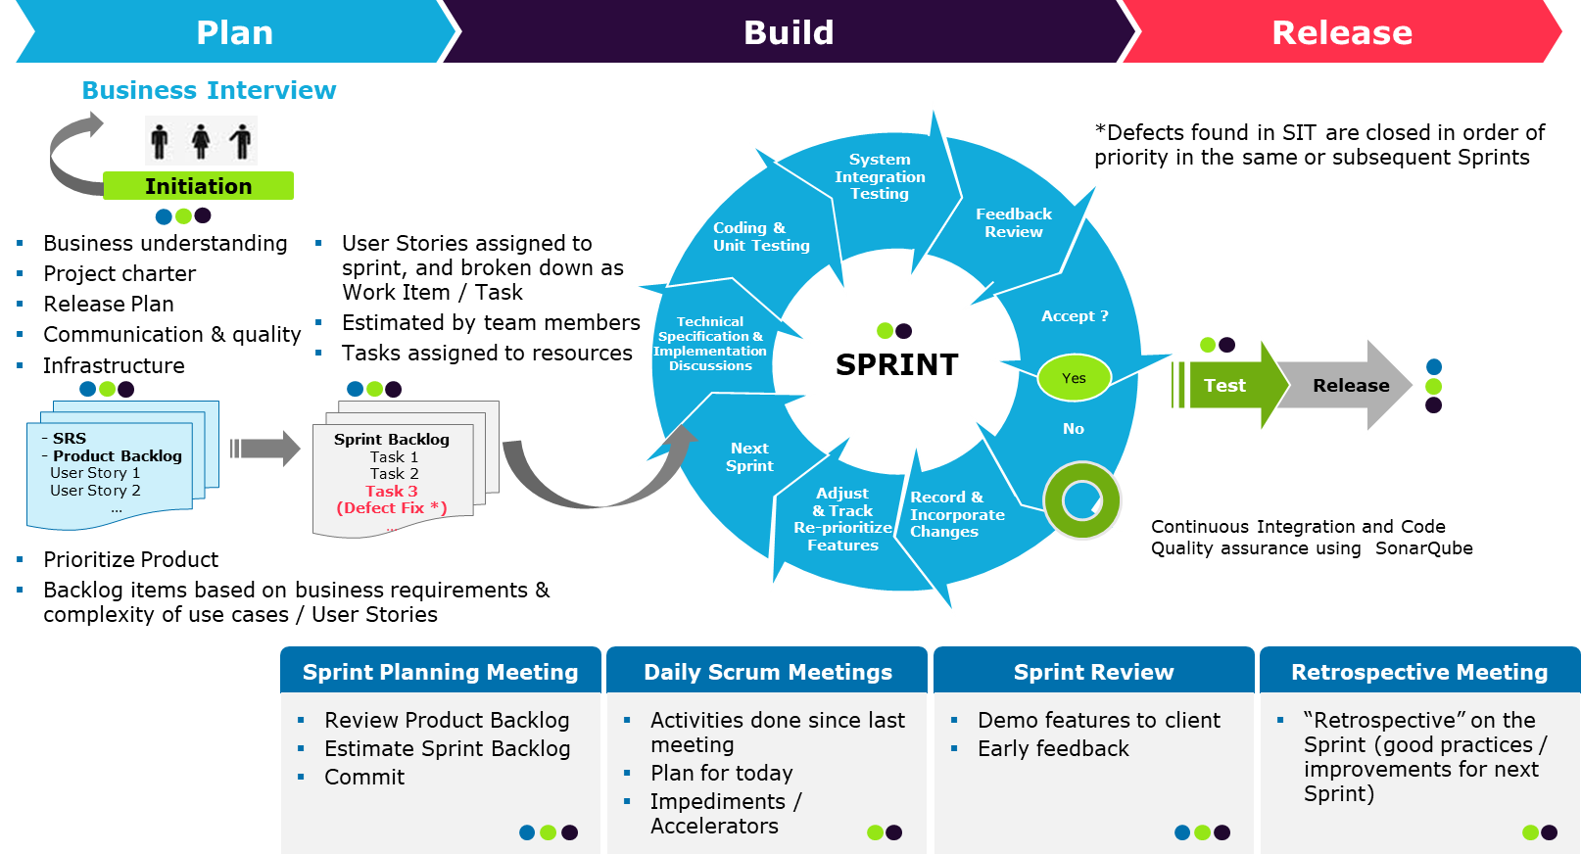




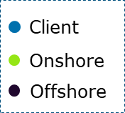
Agile Delivery Model
PEOPLE
PROCESS
Tools
GitHub
ELK
Container Registry
Helm
Azure DevOps
Jenkins
TeamCity
JIRA
Selenium
WhiteSource
SonarQube
Product Owner
The Team
Scrum Master
Service Manager
Other Stakeholder
Communication
Simplicity
Respect
Courage
Feedback
Fun
Customer Focus
Inspect and Adapt
Self-organizing Teams
Small Units of work
Prioritize Continuously
Plan & Measure Continuously
Risk / Value Lifecycle
Early Testing And Delivery
Sogeti Agile Framework
Scalable &
Distributed
VALUES
CONCEPTS
PRINCIPLES
PRACTICE
Highest priority to satisfy Customer
Customer Collaboration
Early & Continuous Delivery
Steered by business Values
Visualization & Transparency
Technical Excellence
Lean Thinking and Principles
Scrum ceremonies
Release Planning
Estimation Techniques
Evolution Architecture & Emergent Design
Refactoring
Continuous Integration & Testing
Metrics
Definition of Ready (DOR)
Definition of Done(DoD)
Distributed Delivery

Slide 16
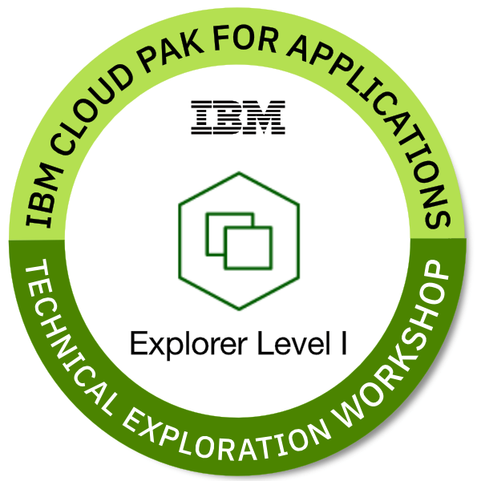
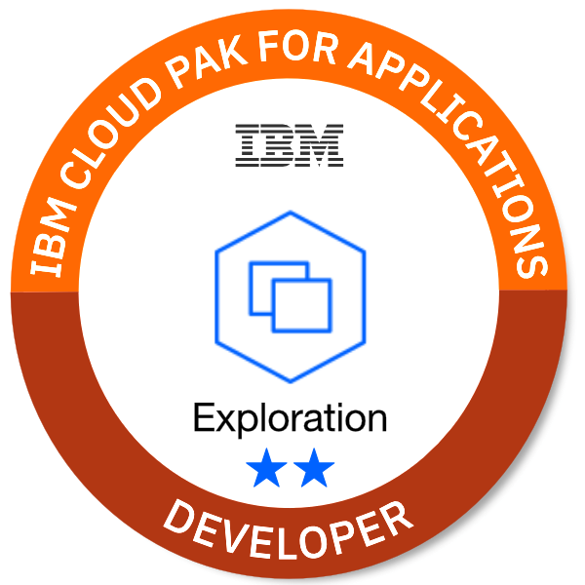
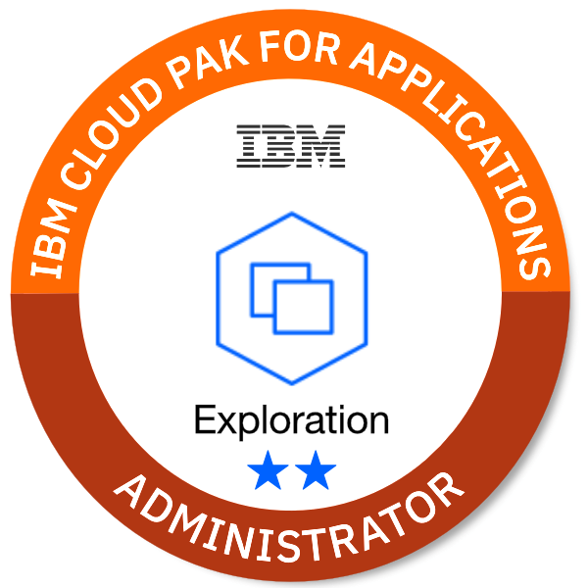






Capgemini/ Sogeti IBM RedHat Cloud Capabilities:
20 IBM CP4A Trained Resources
14 Badges Developer Explorer Administrator
IBM
IBM’s Platinum Business Partner
19 Years of Partnership, focused on helping clients meet increasingly specific business needs.
20+ Countries with IBM Alliance Presence - Our country alliance managers are dedicated to innovating, selling and delivering IBM solutions, backed by teams of Capgemini and IBM experts around the world.
15K IBM PartnerWorld™ Members - Capgemini one of the largest participating companies in IBM’s business partner program.
1st
cloud provider to deliver hyper-data protection & commit to GDPR compliance
170+
services with public, private & local models
RedHat
700+ accreditations globally across middleware, application development, cloud, and data center technologies
150+skilled professionals in Red Hat® OpenShift® globally with training underway for 300+ more across NA and other regions
Champion initiative: Highly engaged and passionate evangelists driving internal capabilities fully supported by Red Hat®
Advanced Delivery Center (ADC) focused on OpenShift® technology.
60+
IBM Cloud data centers across 19 countries & 6 continents
Partner Capabilities
ONE Cloud Architecture
IBM Cloud – Capgemini Capabilities:
127 Certifications globally and still counting…
Redhat:
819 Redhat accreditations and 16 Red Hat active certifications Globally
1,900
Cloud–technology patents granted in 2017 to IBM
* Certifications nos. as on Aug’2019

